Slide 1

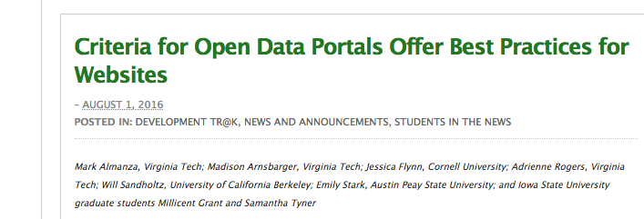
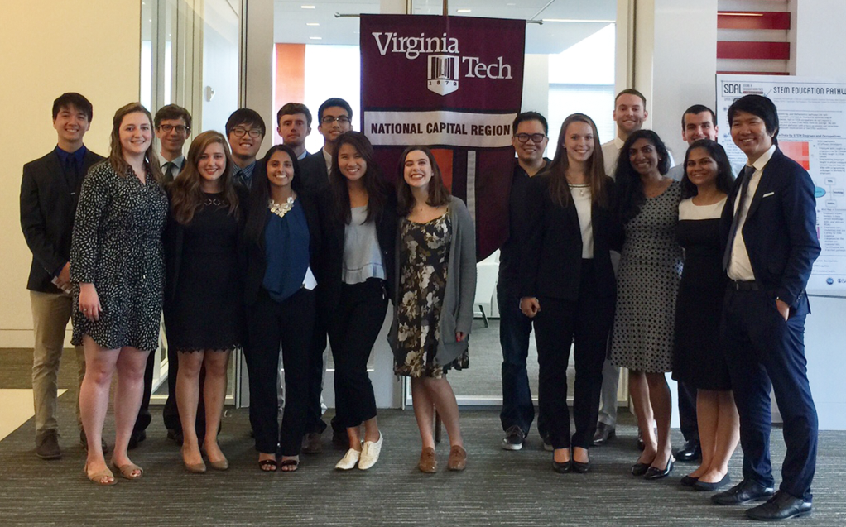





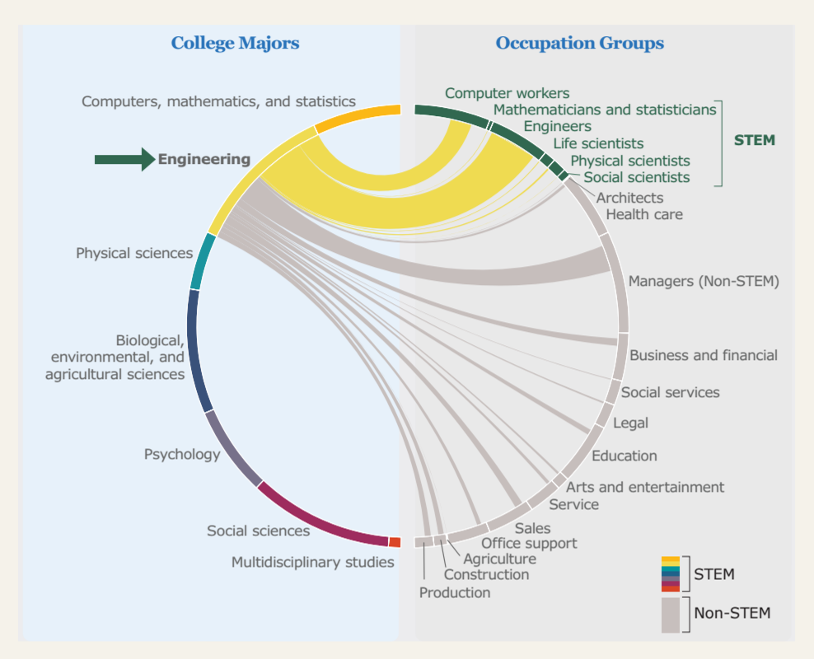
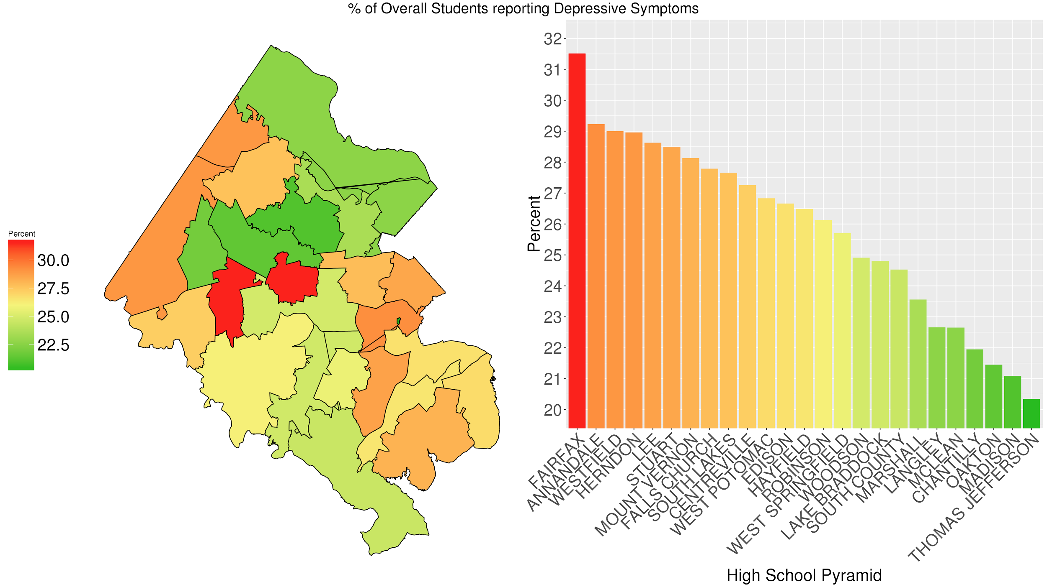
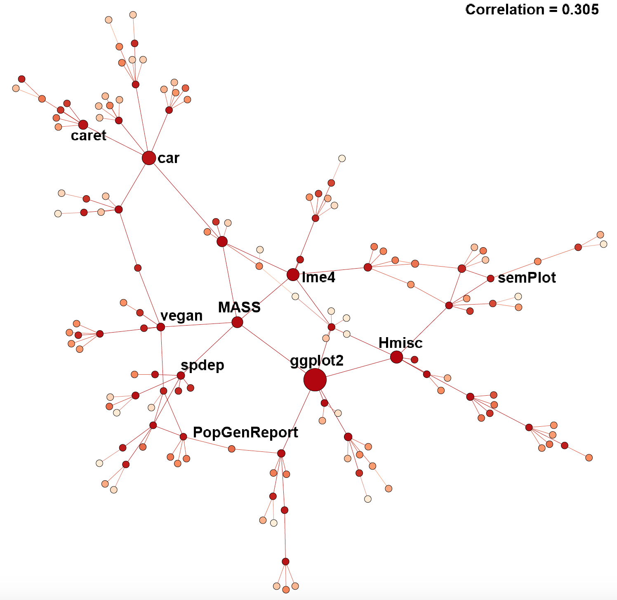
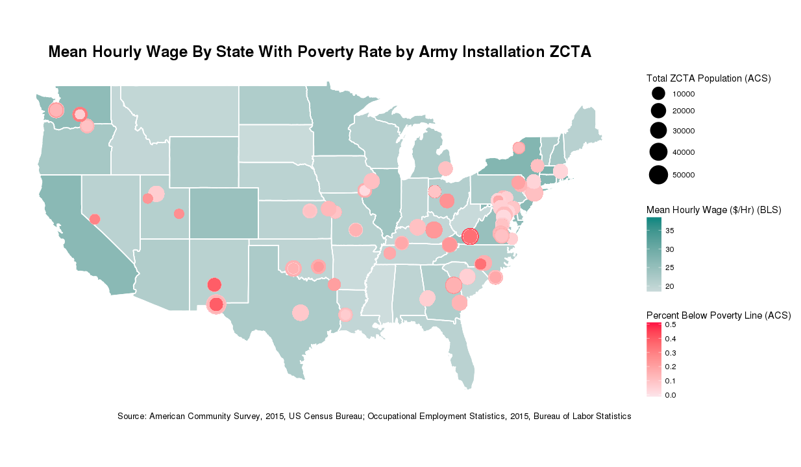
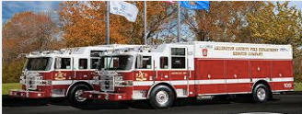
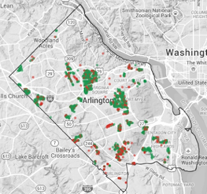

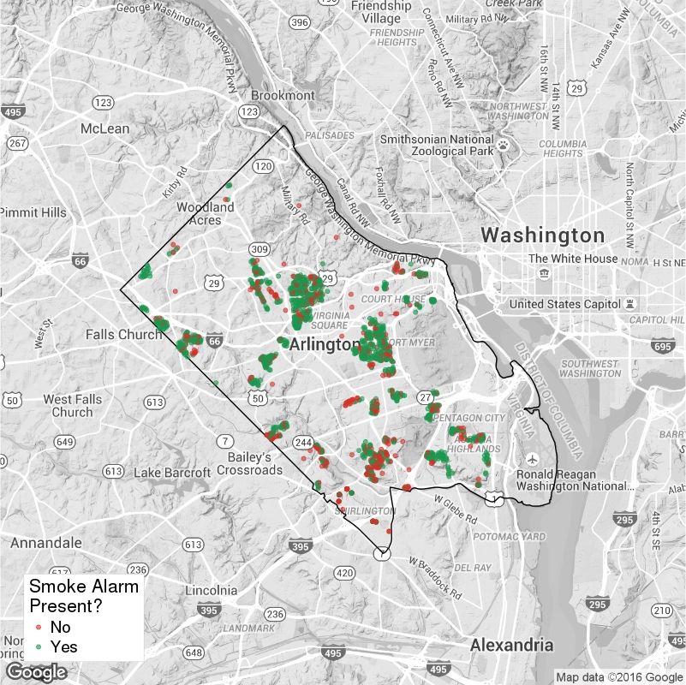



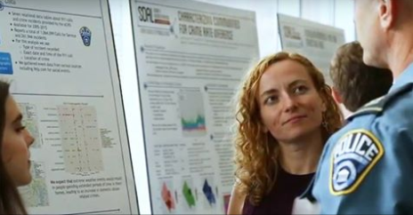

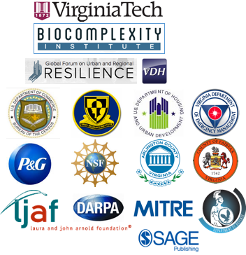
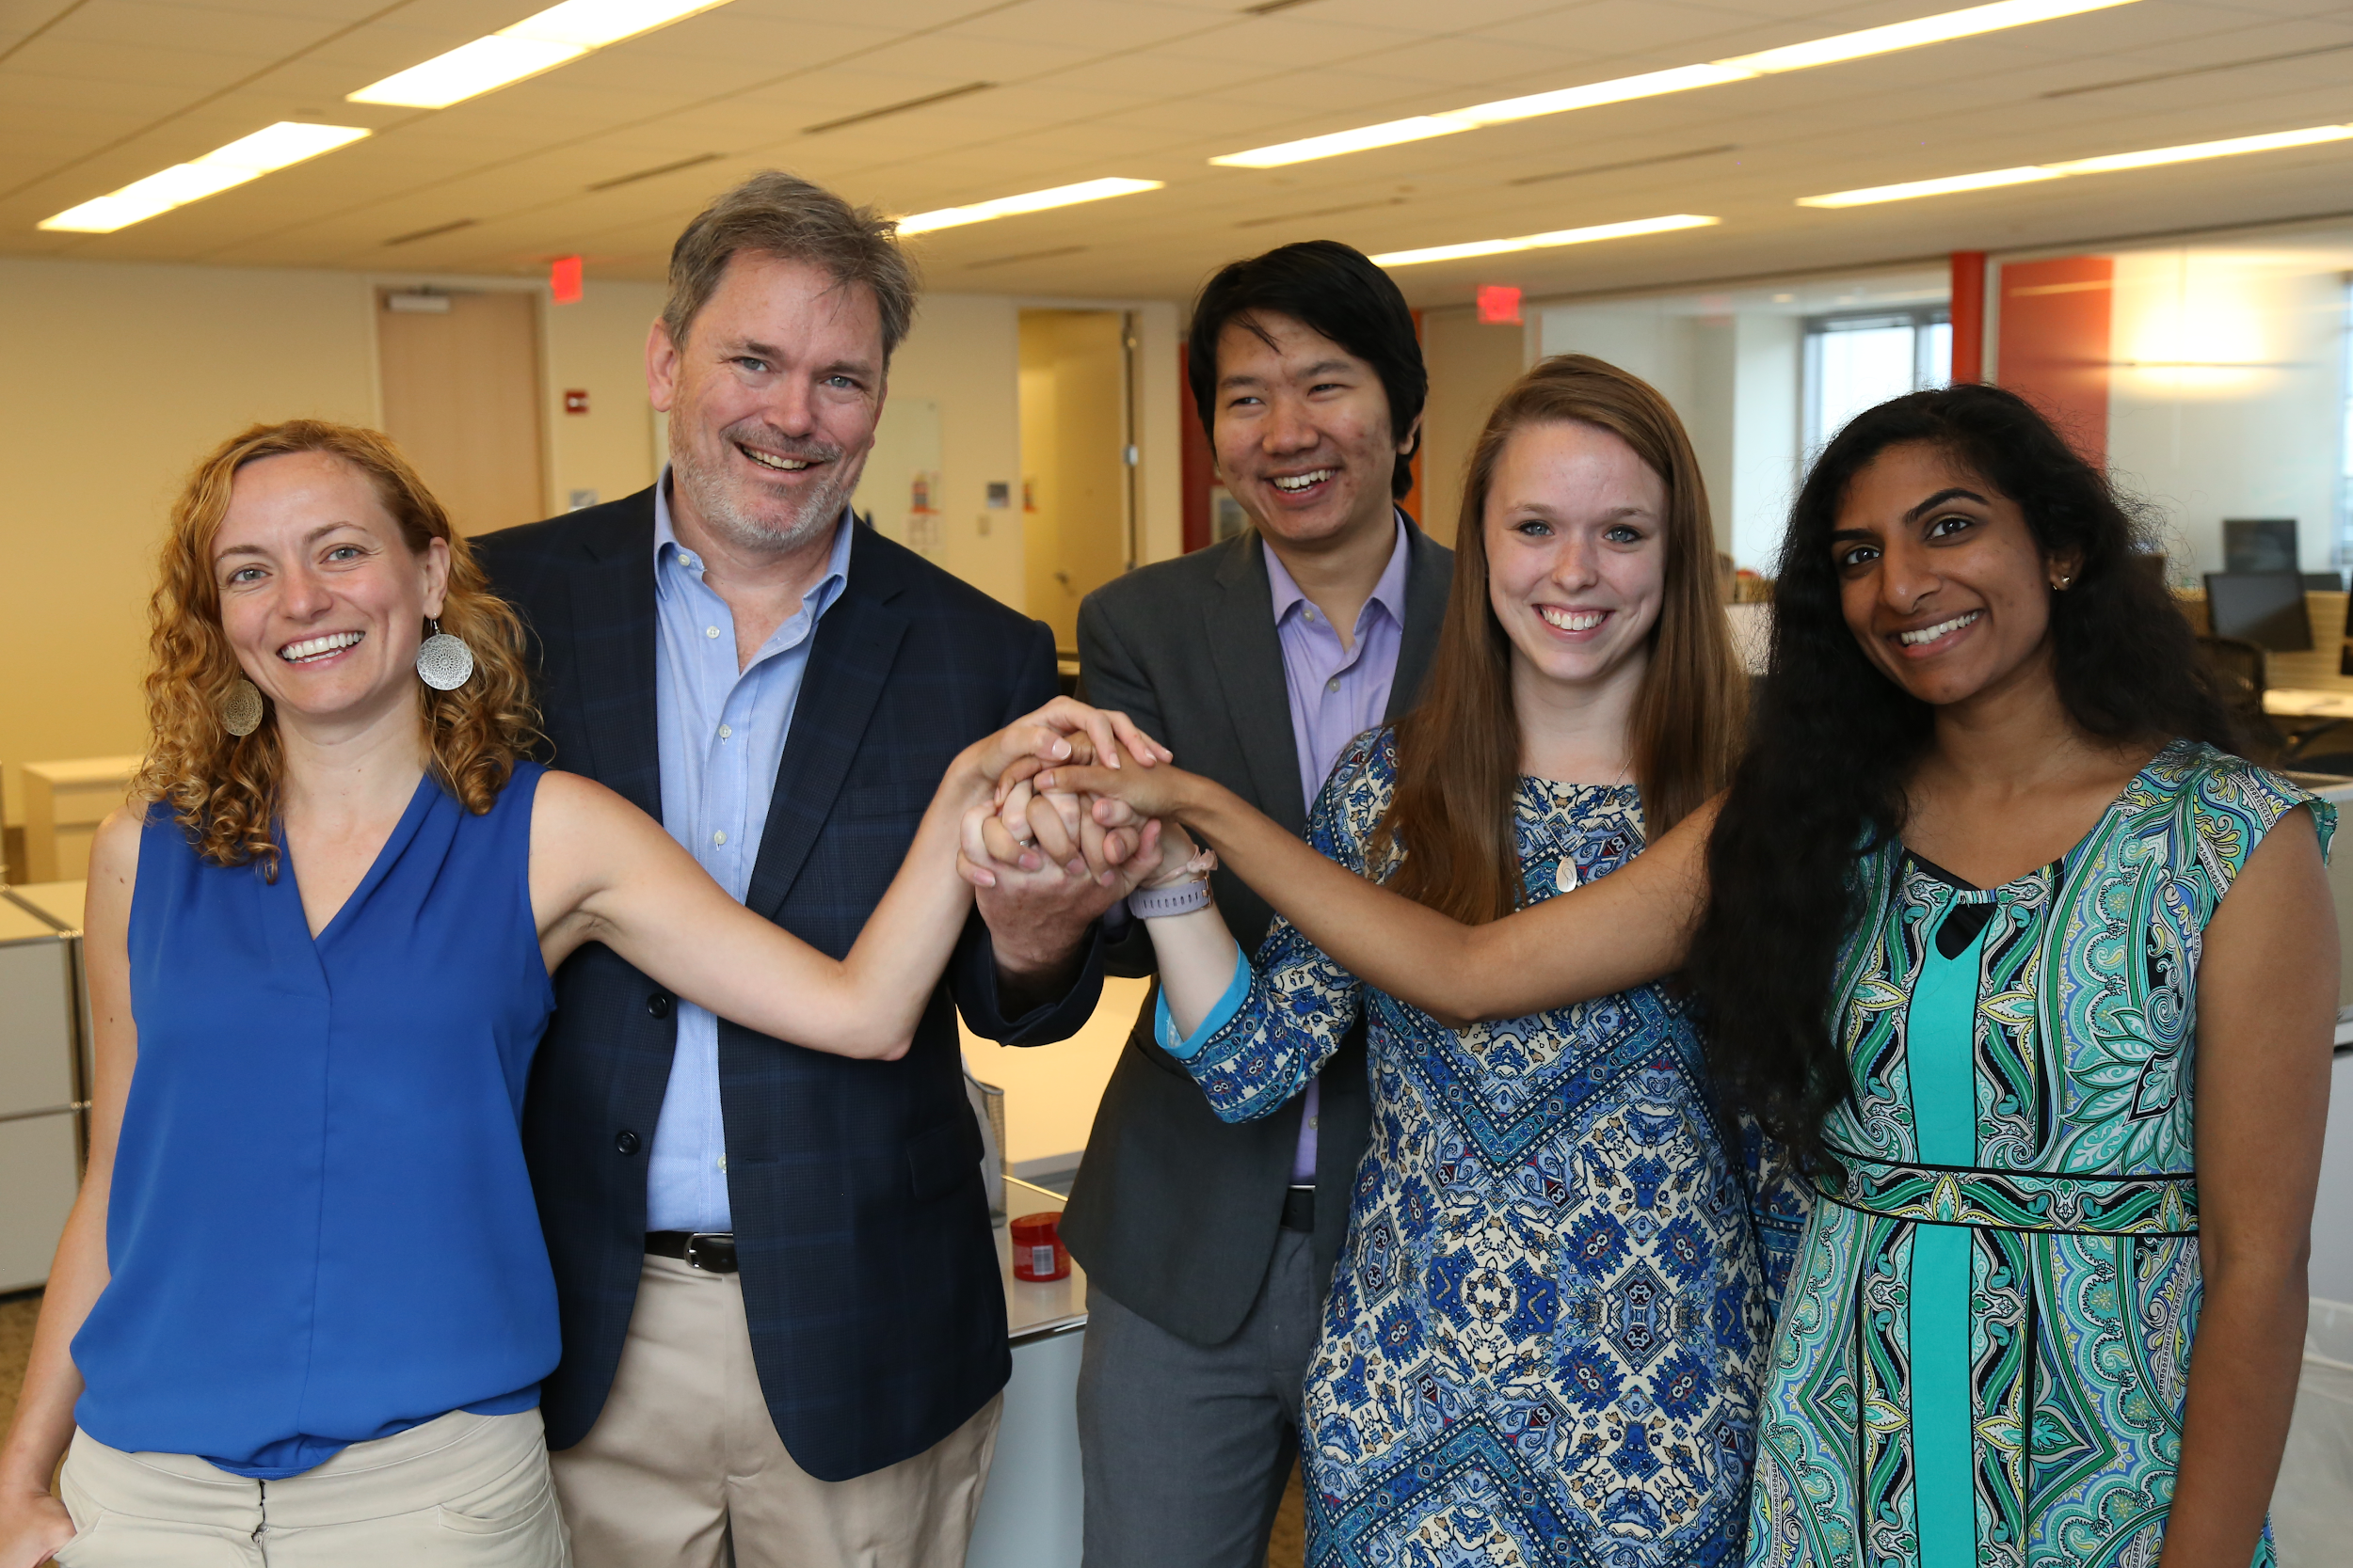



DATA SCIENCE FOR THE PUBLIC GOOD
Delivered by Biocomplexity Institute of Virginia Tech
Directors: Gizem Korkmaz and Aaron Schroeder, Social and Decision Analytics Laboratory (SDAL)
Student Outreach: Dr. Shernita Lee, Education and Outreach (EO)
Program Description
The Data Science for the Public Good (DSPG) program equips new generations of scientists with the skills they need to inform intelligent governmental policy and decision-making. DSPG is delivered by the Social and Decision Analytics Laboratory (SDAL), a leading laboratory in the Biocomplexity Institute of Virginia Tech, located at Virginia Tech Research Center in Arlington, VA. SDAL combines expertise in statistics and social & behavioral sciences to develop quantitative methods and evidence-based research to inform decision-making and evaluation.
Every summer, SDAL researchers and DSPG students team up to work on projects that focus on the interface of data analytics and social science to address real problems at the local, state, and federal levels.
Horizontally and vertically integrated team research (multidisciplinary) with dedicated graduate students, postdocs and faculty
In collaboration with sponsors from local, state and federal governments
Expert training in essential tools for statistical computing, including Hadoop, R, Python, and GIS
Professional training through development workshops and seminars
Individualized mentors working closely with students
Opportunity to interact with decision-makers in industry and government agencies and attend policy events on Capital Hill and the surrounding area
Technical report and publication opportunities
DSPG 2017 fellows, undergraduate students, SDAL faculty and postdocs during a training.
DSPG Fellows
DSPG Undergraduate Students
The program is open to all VT undergraduate students through the Honors college.
Requirement is to enroll in the following courses:
Summer I
UH 4504: Honors Discovery and Innovation Studio (3 credits)
UH 4994: Honors Undergraduate Research (3 credits)
Summer II
UH 4504: Honors Discovery and Innovation Studio (3 credits)
UH 4994: Honors Undergraduate Research (3 credits)
Graduate students (Masters and PhD) enrolled at any U.S. university can apply for funded fellowship positions
Selection through a competitive national search
Possess high quantitative, statistical, computational and programming skills
Lead, support, and guide the VT undergraduate students together with SADL faculty and postdocs
A Wide Variety of Projects
DSPG 2018 fellows, undergraduate students, and alumni during the DSPG Symposium at Virginia Tech Research Center in Arlington.
% of Overall Students reporting Depressive Symptoms
DSPG Symposium
Thanks to Our Sponsors
Local / State Government
Arlington and Fairfax Counties
City of Alexandria
Virginia Department of Health
Virginia Department of Emergency Management
Washington Metropolitan Area Transit Authority
Federal Statistical Agencies
National Center for Science and Engineering Statistics
National Science Foundation
U.S. Census Bureau
Housing and Urban Development
Department of Defense
U.S. Army Research Institute
Defense Advanced Research Project Agency
The Minerva Research Initiative
Industry
MITRE Corporation
Proctor & Gamble
Foundations
Robert Wood Johnson
Laura and John Arnold
DSPG Directors Gizem Korkmaz and Aaron Schroeder
with 2018 Fellows Zarni Htet (NYU), Claire Kelling (PSU) and Lata Kodali (VT)

